Slide 1
INTRODUCTION TO FOREX TRADING
E-Course
by
LearnFX.net

Slide 2
Instructional Goals
To provide an Overview of
What is the Forex Market.
To provide an Overview of How the Forex Market works.
To provide an Overview of the key elements involved in trading.

Slide 3
Test Your Knowledge
After you have completed your E-course - you will be able to test your knowledge

Slide 4
Lesson 1: What is Forex Trading

Slide 5
Forex Defined
(For)eign (Ex)change - Forex is the acronym for Foreign Exchange.
Foreign Exchange is the transfer of different currencies between parties.
When a US citizen goes to the store and buys coffee in the United States, he/she takes
dollars and pays for the coffee and gets change back in dollars. But when that same
person travels to the United Kingdom and buys coffee, he/she has to exchange
the dollar to British Pounds. When European investors buy US stocks they
have to first Sell their currency (The Euro) and buy US dollars to acquire US those
stocks.
When the US Equity Markets have a big down day, foreign owners of stocks sell those
stocks, sell Dollars, and buy back their currencies pushing the EURO up in value!
Currency trading or Forex - makes the world work!

Slide 6
HOW BIG IS THE FOREX
MARKET?
Forex is the worlds Biggest of all markets because all economic activity has to ultimately be translated to cash in some currency.
Forex activity never stops!
Forex is used by anyone exchanging currencies for any reason …
Travel
Import/Export
Governments
Investments

Slide 7
WHY FOREX IS IMPORTANT
Forex is important because it is a key measure of the world economy. World currencies flow
between countries and that flow affects everyone in the world!
Size of Markets:
US EQUITY MARKET -$10 BILLION
US TREASURY AND BONDS-$300BILLION
FOREX - $ 1.5 TRILLION!

Slide 8
WHY IS FOREX IMPORTANT TO YOU?
Forex Is Important To You Because It
Provides An Opportunity To Individuals
Anywhere To Achieve A Second Career Or
Income; Right From The Desktop; No
Matter How Old They Are.
What Was Once Only The Domain Of The
Powerful And Rich Is Now Available To
The Individual.

Slide 9
UNDERSTANDING CURRENCY PAIRS
Forex has its own terms. In the world of Forex currencies are called currency pairs.
USD/USD GBP/USD
EUR/USD USD/JPY
USDCHF CHF/USD
A currency pair is simply one currency expressed in terms of the other.
If two currencies are equal then they would be valued at 1:1 . In reality, the dollar in The United States is really a currency pair - the USD/USD!
When the EUR achieves Parity with the Dollar, the EURUSD is worth 1.00 or one dollar.

Slide 10
Lesson 2- Understanding Currency Pairs

Slide 11
HOW TO READ CURRENCY PAIRS ON CHARTS
When looking at a price chart of a Currency Pair, the chart is tracking the direction of the numerator.
The first term is also called the base currency.
The Second term is called the counter currency.
On the following chart USDJPY, if the chart is
going up, the first term is getting larger- It means the Dollar is strengthening and the JPY is weakening.

Slide 12
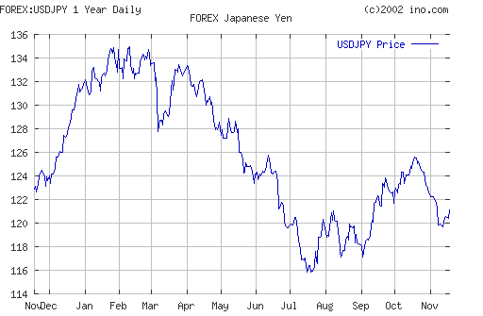
charts
USD Weakening
The USDJPY is the currency pair. When the chart shows the price going down, the USD is weakening.

Slide 13
Lesson 3
How Forex Trading Works
Forex Trading occurs largely between banks.
About 10,000 banks trade. Large funds and Corporate trading generates more than 95% of Global forex trading.
Nike Corporation, for example, has 20% of its net income affected by currency exposure. Over $1 billion is traded by that company to hedge their Exposure!

Slide 14
Desktop Currency Trading
Desktop Trading arrived recently providing the ability for any person to trade on-line from their home or office.
What was the domain of institutions has become accessible because of innovations in platforms and the internet.
Forex is truly the on-line revolution of the 21rst Century.

Slide 15
Currency Order Flow
Step 1: Customer enters a currency order via computer: (buys or sells pair)
Step 2: Dealing Desk Receives Orders
Step 3: Dealing Desk fills order for customer Dealing Desk offsets order
Step 4: Customer closes order

Slide 16
Lesson 4
Understanding
BID-ASK
Currency Pairs are available on a Bid - Ask Basis.
This is a negotiated market! There is no one Exchange listed price! Similar to the bond market.
This results in a Spread.
Spread: Difference between Bid and Ask is commonly 5 pips.
Customer Buys at the Ask and Sells at the Bid.

Slide 17
BID-ASK
A QUOTE IS A SIMULTAINEOUS
PRESENTATION OF THE BID/ASK
BID ASK
99.00 99.05
Buyers will be filled at 99.05
Sellers will be filled at 99.00
Note: Price charts are really charts of the bid price!

Slide 18
PIPS
A Pips (Price Increase Point) is the smallest unit of price for any Foreign Currency Pair Movement.
Example
If the EURUSD moves from 99 to 1.00 it has moved 100 pips.
If the USDJPY moved from 122.0 to 123.0 it is 100 pips.
If the EURUSD moves from 99 to 99.01 it is a 1 pip move

Slide 19
Pip Calculator
http://208.34.212.202/pipcal.htm
Use this calculator to quickly determine pip values.

Slide 20
Lesson 5
Leverage and Margin
Forex allows leverage in trading.
A currency contract of $1,000 (1 lot) is leveraged 100:1 which equates to $100,000
If 20 pips profit were captured in a trade in the EURUSD, $200 would be credited to the account value. It also cuts the other way:
If 20 pips move against you are debited $200

Slide 21
Margin Example
Mr. Chan uses his Currency Manager deposit to open a margin line equivalent to 10 times the initial deposit of USD 100,000. He thinks that the USD exchange rate against JPY is on the rise and buys USD against JPY at rate 125. Assuming 2 weeks later, the exchange rate rises to 130 and Mr. Chan squares the position:
Simple interest rate method is needed in this example. Actual interest is calculated on daily compounding basis.
Return Calculation
Long Position: Buy USD = US$1,000,000
Balance after 14 days
= US$1,000,000 + (US$1,000,000 X 5.5% X 14/360)
= US$1,002,138.89
Short Position: Sell JPY = (1,000,000 X 125) = 125,000,000
Balance after 14 days,
= 125,000,000 + (125,000,000 X 0.7% X 14/360)
= 125,034,028
Square Position:
Sell USD vs. JPY = (US1,002,138.89)@130 = 130,278,056
Total Gain = 130,278,056-125,034,028 = 5,244,028
Gain in USD = US$(5,244,028/130) = US$40,338.68

Slide 22
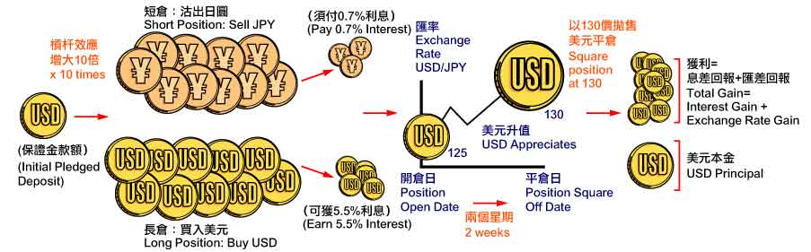
Margin Example

Slide 23
MARGIN CONTROL
In trading keeping your account balance with excess margin is critical.
If accounts become thin in margin, the trader will need to:
a) get out of positions, winning positions,
to avoid a margin call; and
b) add money.
Margin Excess - Available funds in the client’s account not currently being used to support existing trading positions, which can be used to open new positions.

Slide 24
Trading Sessions
Asia: 7 PM EST
Europe: 1AM EST
US 9:30 AM EST
These are estimated times and in effect the market never stops. For purposes of accounting each firm selects a daily cut-off time to mark the end of a session.

Slide 25
Lesson 6
Understanding Fundamentals
Fundamentally currencies are deeply related to the economy of their countries and regions.
In periods of strong economic health, currencies tend to go up in value. In periods of high inflation, they go down in value. In periods of low interest rates they tend go down in value.
Fundamentals are important to enable a longer term perspective on currencies.

Slide 26
CURRENCY- FUNDAMENTALS
EURUSD
EUROLAND ECONOMY OF 12 COUNTRIES IS OFTEN DEPENDENT ON US GROWTH. EURUSD CHART PATTERN IS OFTEN IN A RANGE.
EURUSD OFTEN REACTS TO US MARKETS. IF US EQUITIES ARE DOWN-EUR MOVES UP AND VICE-VERSA.
HOWEVER, IF US MARKETS HAVE A VERY BAD DAY, THEN FEAR OF ECONOMIC DECLINE IN WORLD CAN ALSO FOLLOW WITH EUR DECLINING!

Slide 27
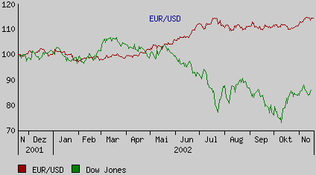
EURUSD and DOW
EURUSD Counter trend vs DOW

Slide 28
USDJPY- Fundamentals
Japan is in a deep long term recession.
Economies in a recession need liquidity and there is pressure for a weak currency.
When the chart of USD/JPY is up, it is reflecting this weakness.

Slide 29
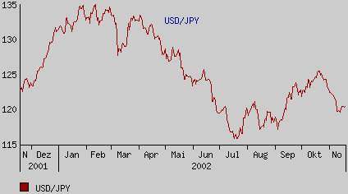
USDJPY
Yen weakening when rising

Slide 30
USDCHF-SWISS FRANC
This currency often acts as a reserve when Money flows out of US and out of Euro.
The USDCHF exhibits strong trends and is partially backed by gold. Position plays in this currency is a favorite among traders.

Slide 31
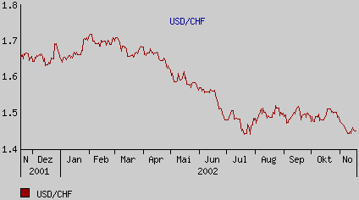
USDCHF
Swiss weakness
Resistance

Slide 32
GBPUSD -Fundamentals
Similar in price action to the EURUSD. GBPUSD often parallels the EUR.
But it can diverge and give trading opportunities.

Slide 33
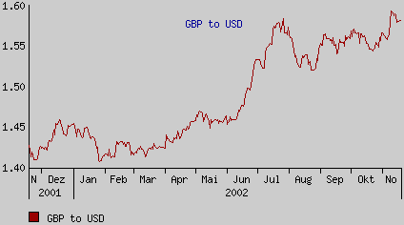
GBPUSD

Slide 34
AUDUSD & USDCAD
These currencies while not part of the 4 Majors reflect the strong commodity based resource economy of those nations.
Gold prices and the CRB index can be a guide to their trend.

Slide 35
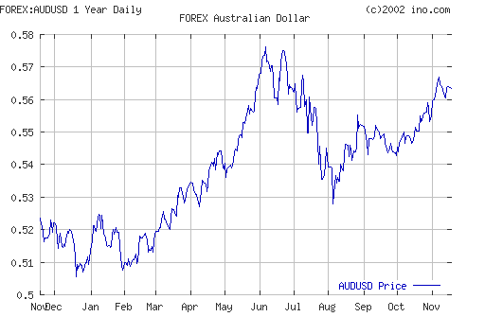
AUDUSD
AUDUSD TRENDS

Slide 36
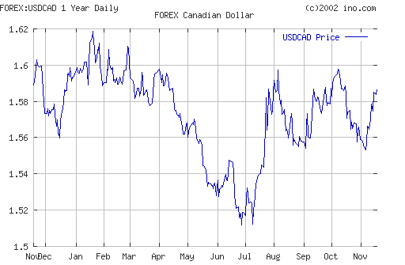
USDCAD

Slide 37
GLOBAL ECONOMICS
Currencies are a play on the economy of a country or region. Therefore their valuations reflect important Macro-economic principles.
The key economic principle is that money goes to where it will gain a greater return.
If interest rates go up- a currency will tend to attract money flow;
If growth rate increases- a currency will get stronger.
If uncertainty prevails- currency values will increase in volatility

Slide 38
WEAK CURRENCIES STIMULATE EXPORTS
A weak currency stimulates exporting
A country like Japan is in a recession and Needs more money to come into that country. A weaker yen means Hondas are cheaper to US buyers. A stronger dollar will mean Hondas become more expensive in US and less sales.
Years ago when the US Dollar was extremely strong, US citizens flew to Germany, purchased, Mercedes Benz’s and shipped them to the USA - and still achieved savings!

Slide 39
Currencies affect the consumer
A low EURUSD means cheaper European Goods for US citizens. A EUR moving to Parity and above, means cheaper US goods for Europeans.
But too strong a EURUSD will raise fears of a reduction in purchasing from the US! The European Central Bank may move to buy dollars to keep the Euro not too strong.

Slide 40
Currencies and Governments
The global nature of currencies means it is difficult to manipulate.
Governments try to affect the value of the currency by:
increasing/decreasing interest rates in their countries;
Buying/selling their currencies; and
Jaw-Boning- threatening to the press to intervene !

Slide 41
The Effects of Exchange Rate Changes
An exchange rate is the price of one foreign currency in terms of another currency. Foreign exchange rates are of particular concern to governments because changes in FX rates affect the value of products and financial instruments. As a result, unexpected or large changes can affect the health of nations' markets and financial systems. Exchange rate changes also impact a nation=s international investment flows, as well as export and import prices. These factors, in turn, can influence inflation and economic growth.
For example, suppose the price of the Japanese yen moves from 120 yen per dollar to 110 yen per dollar over the course of a few weeks. In market parlance, the yen is A "strengthening," or becoming more expensive, against the dollar. If the new exchange rate persists, it will lead to several related effects. First, Japanese exports to the United States will become more expensive. Over time, this might cause export volumes to the United States to decline, which, in turn, might lead to job losses in Japan. Also, the higher U.S. import prices might be an inflationary influence in the United States. Finally, U.S. exports to Japan will become less expensive, which might lead to an increase in U.S. exports and a boost to U.S. employment..
Interest rate differentials between countries are one of the main factors that influence exchange rates. Money tends to flow into investments in countries with relatively high real (that is, inflation-adjusted) interest rates, increasing the demand for the currencies of these countries and, thereby, their value in the FX market.

Slide 42
Bank Analysis of Currencies Help Trader Track Fundamentals
November 15, 2002 11:16 a.m. HK Time
Greenback received extra support on the back of strong data. October Retail sales was unchanged against expectation of 0.2% decline. Retail Sales less autos for the same period rallied by 0.7% above the consensus of 0.3%. Initial jobless claims for the past week further reduced to 388K. U.S. stocks boosted on strong data. Iraq's decision to accept the UN resolution eased the uncertainty. It helped to improve the sentiment of USD. Market now waiting for the upcoming release of Oct industrial production and Nov University of Michigan Confidence index. USD may be able to extend the rally if both data were better than expectation. Euro gradually declined yesterday. The resistance was intact as market disappointed over the economic performance of the region. Euro capped at 1.0099USD even when European indexes performed well. The later rally of U.S. index and strong data invited fresh selling pressure on the common currency. It dropped to near 1.0030USD before met initial support before closed at 1.0042USD. It is expected that the release of U.S. data will be crucial to the Euro with chance to lose the support of parity today. GBP declined but in a larger extend compared to Euro. It recently traded below 1.5900USD suggested heavy resistance. GBP rose to 1.5893USD day high before reversed the uptrend. HSBC announce the acquisition of U.S. Household raised concern over the future selling pressure on GBP. It broke below 1.5800USD on USD strength before closed at 1.5791USD. USD/JPY rose on speculation that BoJ may intervene in the market. The recent movement suggested USD have bottomed out at 119.11JPY with chance to test resistance of 121.80JPY in near-term.

Slide 43
Purchasing Power Parity
Purchasing power parity (PPP) is a theory which states that exchange rates between currencies are in equilibrium when their purchasing power is the same in each of the two countries. This means that the exchange rate between two countries should equal the ratio of the two countries' price level of a fixed basket of goods and services. When a country's domestic price level is increasing (i.e., a country experiences inflation), that country's exchange rate must depreciated in order to return to PP
http://pacific.commerce.ubc.ca/xr/PPP.html
The Big Mac Index
This index provides a very accurate picture of relative PPP for countries by comparing the price of a Macdonald Hamburger in different nations. In theory, the Big Mac should cost the same everywhere! When it doesn’t one of the currencies
is overvalued!
http://www.economist.com/markets/bigmac/displaystory.cfm?story_id=472727

Slide 44
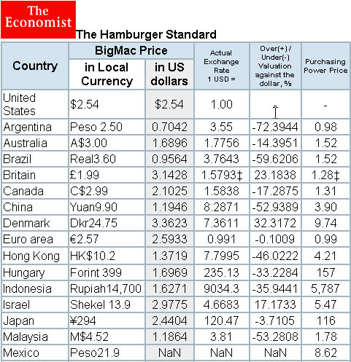
BIG MAC INDEX

Slide 45
Lesson 7
US DOLLAR INDEX
An important fundamental factor in trading is the value of the USDOLLARINDEX This index is a basket of currencies against the dollar.
Watching its movement can be used to improve trading success and pinpoint if the dollar is in a BULL trend or a Bear Trend, or simply in a sideways action.

Slide 46
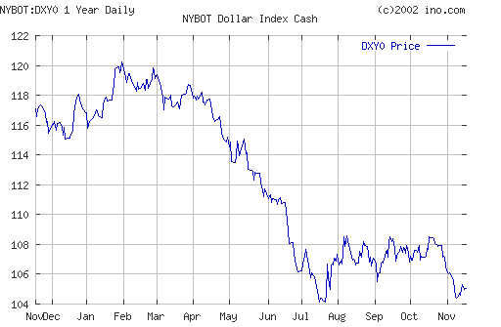
US DOLLAR INDEX
Decline of Dollar!

Slide 47
USDX and CRB Index
One of the best baskets available to measure the dollar©ˆs real value is the CRB Index. It consists of six commodity categories: energy, precious metals, grains, livestock, softs and industrials, and includes 17 different commodities. It is a nice cross section of real goods used by real people in the real world. Traders should monitor the dollar index/CRB index relationship from time to time to get a reality check.
Starting in late 2001, the dollar and the CRB index relationship has appeared as a mirror image -- you can see that in the chart below. It reflects a decline in the real value of the dollar.
The dollar has broken its seven-year uptrend. The CRB Index has broken its seven-year downtrend. That is a major fundamental and technical shift in the relationship between the USDX and the CRB. Traders should watch this relationship in 2003.

Slide 48
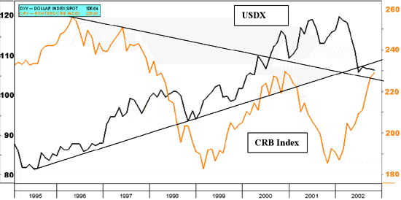
USD and CRB Index

Slide 49
Key Government Agencies and Economic Web Sites
Following up on Fundamentals can be achieved by reviewing these sites:
http://www.federalreserve.gov/
http://www.boj.or.jp/en/
http://www.ecb.int/

Slide 50
Lesson 8
Technical Analysis
Understanding price movement and how to evaluate charts is the goal of technical analysis.
The premise of Technical Analysis is :
Forex Market is non-random.
Prices reflect all underlying factors.
Knowledge of charts gives traders an edge.

Slide 51
PRICE AND TIME
In trading Forex, many charts are available covering different time frames. Each time frame provides important clues to changes in trend direction and momentum.
MONTHLY - Big Picture of Global Forces
WEEKLY- Still a big picture of Prices
DAILY- Trends here visible
HOURLY
15 MINTUES
5 MINUTES 1 MINUTE
TICK

Slide 52
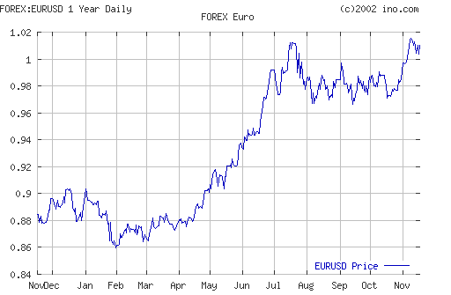
MONTHLY CHART

Slide 53
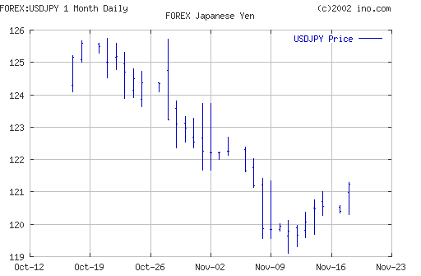
DAILY CHART

Slide 54
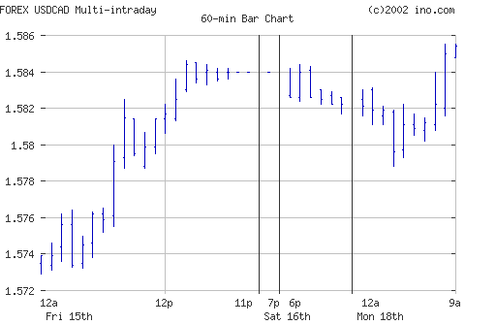
HOURLY CHART

Slide 55
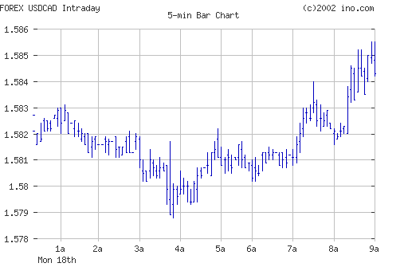
5 MINUTE CHART

Slide 56
TYPES OF CHARTS
LINE
BAR
CANDLE
POINT AND FIGRE
KAGI
RENKO
3LINE BREAK

Slide 57
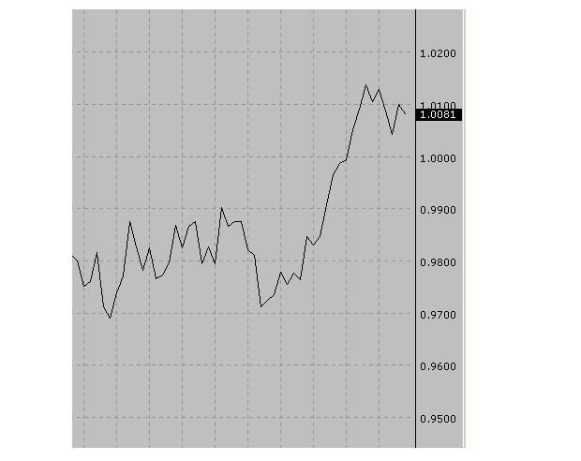
Line Chart

Slide 58
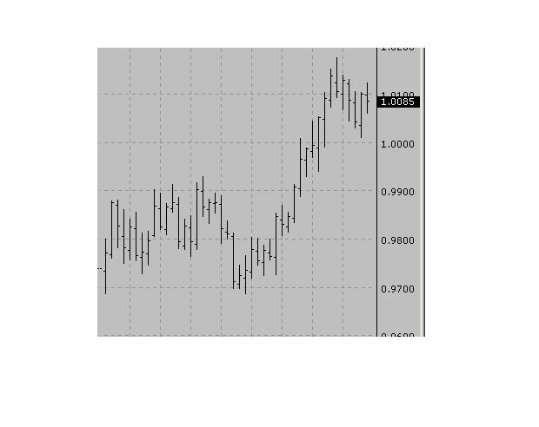
BAR CHART

Slide 59
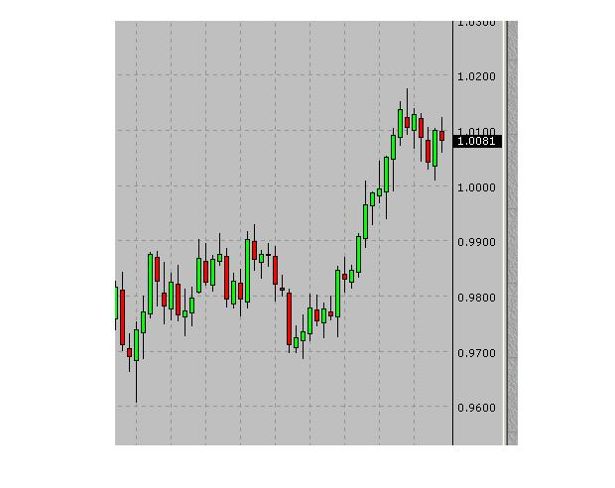
Candlesticks

Slide 60
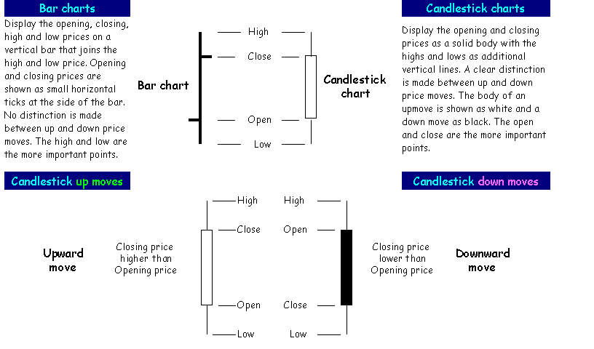
Bar vs Candlestick

Slide 61
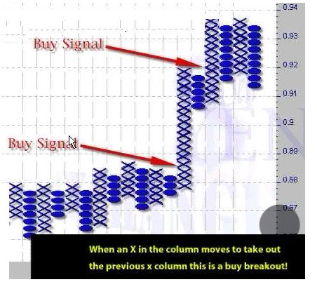
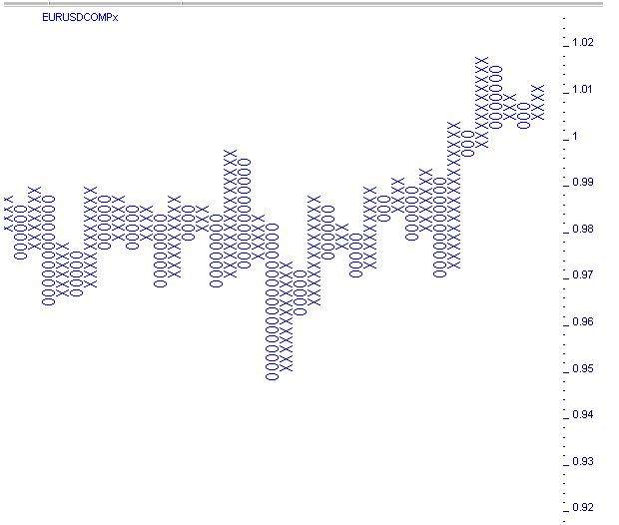
Point and Figure

Slide 62
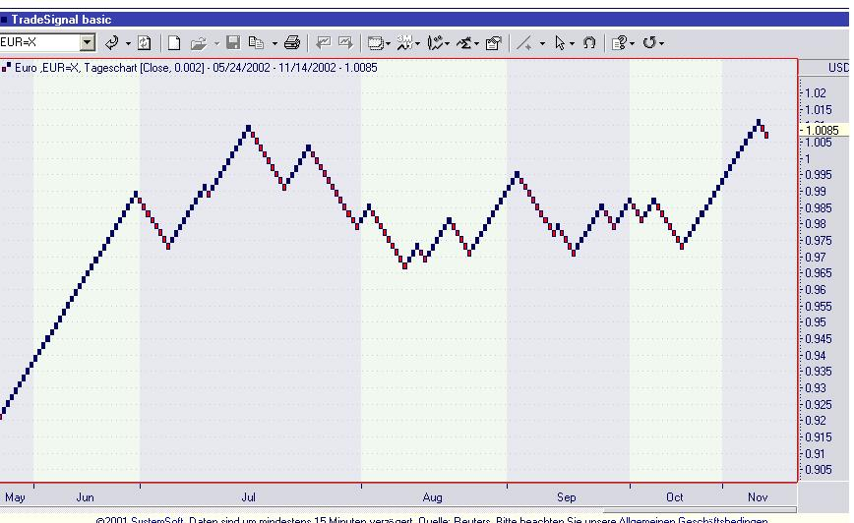
Renko Chart

Slide 63
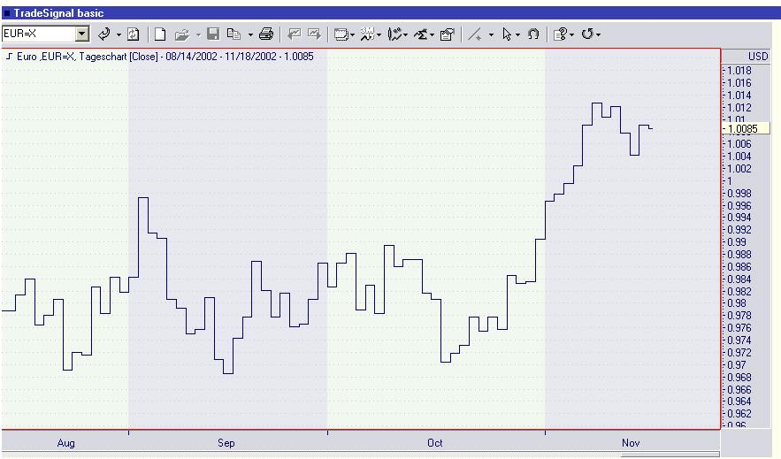
Kagi Chart

Slide 64
Lesson 9
PRICE MOVEMENTS
UP
DOWN
SIDEWAYS
CHANNEL
SURGES/SPIKES

Slide 65
SUPPORT AND RESISTANCE
When prices stop moving down they have reached a level of support.
When prices stop moving up they have reached a level of resistance
Once you have picked Support and Resistance you know - THE RANGE

Slide 66
Lesson 10
Trend Lines
Trend definition:
UPTREND- Higher Highs and Higher Lows.
DOWNTREND- Lower Highs and Lower Lows.
Trendlines can be Inner and Outer and act as
Support and Resistance areas.

Slide 67
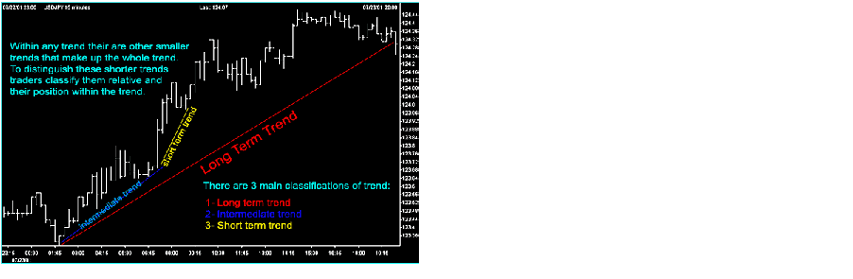
Trend Construction

Slide 68
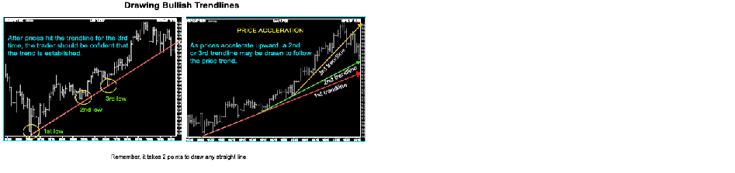

Slide 69
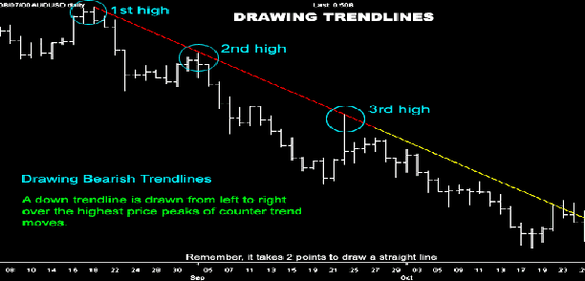

Slide 70
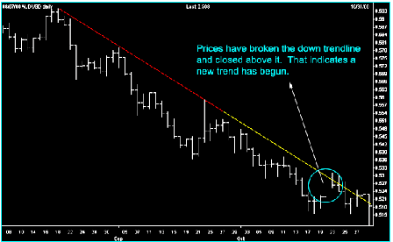

Slide 71
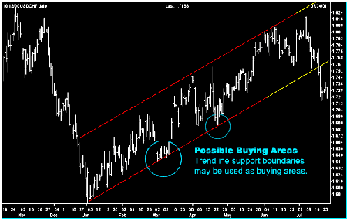

Slide 72
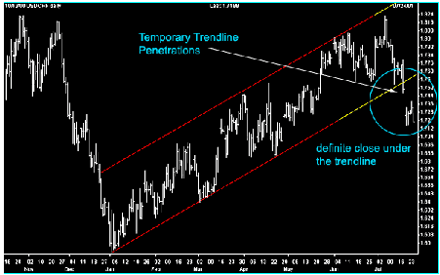

Slide 73
Lesson 11
PATTERNS
Prices move in Patterns and break out of those patterns.
Each Pattern contributes to confirming a trading strategy.

Slide 74
KEY PATTERNS
Fibonacci Movements
Elliot Wave
Head and Shoulders
Triangles
Wedges
Gann

Slide 75
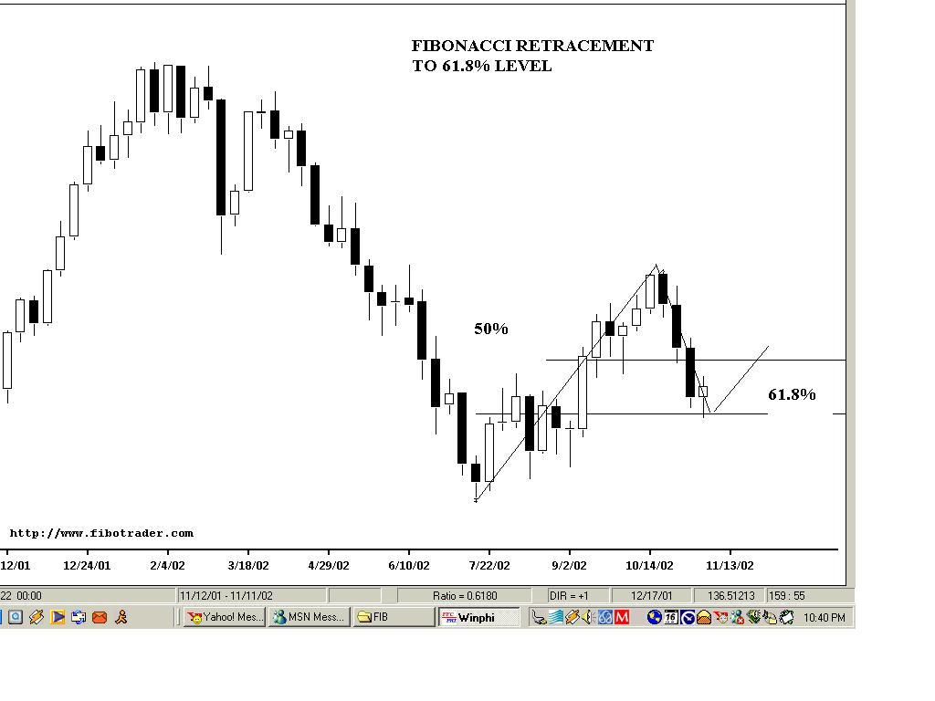
Fibonacci Retracement

Slide 76
Lesson 12
TECHNICAL INDICATORS
Technical Indicators are used to quantify the price movements to determine, price momentum, trending tendencies, and provide a basis for entering and closing a position.
Technical Indicators help identify buyingand selling opportunities.

Slide 77
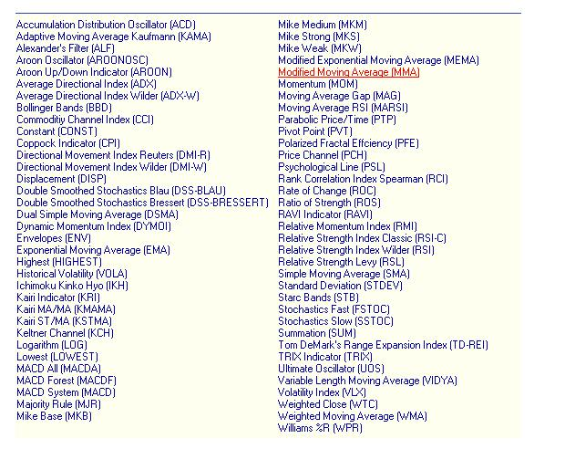
There are Many Indicators

Slide 78
Different Indicators
Moving Averages (simple, exponential, weighted)
Moving Average Crossovers
Oscillators ( RSI, MOM)
Price Movement as indicators indifferent Time charts
Intermarket Analysis

Slide 79
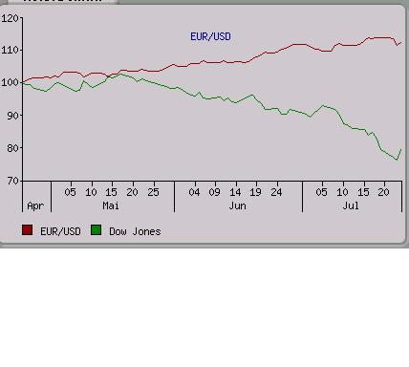
EURvsDOW

Slide 80
RSI
The Relative Strength Index (RSI) is a popular oscillator used by commodity traders. It was first introduced by J. Welles Wilder in an article in Commodities (now known as Futures) Magazine in June, 1978. Step-by-step instructions on calculating and interpreting the RSI are also provided in Mr. Wilder's book, New Concepts in Technical Trading Systems.
The RSI is a fairly simple formula, but is difficult to explain without pages of examples. The basic formula is:
RSI=100-(100/(1+U/D))
Where:
U = An average of upward price change.
D = An average of downward price change.

Slide 81
RSI
When Wilder introduced the RSI, he recommended using a 14-day RSI The RSI is a price-following oscillator that ranges between 0 and 100. A popular method of analyzing the RSI is to look for a divergence in which the market is making a new high (low), but the RSI is failing to surpass its previous high (low). This divergence would be an indication of an impending reversal. When the RSI then turns down and falls below its most recent trough, it is said to have completed a failure swing. The failure swing would be considered a confirmation of an impending reversal.
1. Tops and Bottoms: The RSI usually tops above 70 and bottoms below 30. The RSI usually forms these tops and bottoms before the underlying price chart. When the RSI crosses through the 50 mark it is also considered a
Buy or sell signal.
2. Chart Formations: The RSI often forms chart patterns (such as head and shoulders or rising wedges) that may or may not be visible on the price chart.
3. Failure Swings (also known as support or resistance penetrations or breakouts): This is where the RSI surpasses a previous high (peak) or falls below a recent low (trough).
4. Support and Resistance: The RSI shows, sometimes more clearly than the price chart, levels of support and resistance.
5. Divergence: As discussed above, this occurs when the price makes a new high (or low) that is not confirmed by a new RSI high (or low).

Slide 82
Momentum
The Momentum indicator is the ratio of today's price compared to the price x-periods ago:
Momentum = Close / (Close x-time periods ago) * 100
The time period we are using is 10 days.
Interpretation:
Similar to the RSI, there are more ways to use the Momentum, three are explained here:
* As a trend-following oscillator: Buy when the indicator bottoms and turns up and sell when the indicator peaks and turns down.
* Trend recognition: Just use this method in combination with other indicators. Values below 100% are indicating that the price is making a downtrend, whereas values above 100% are indicating an uptrend of the price.
* Divergence: Occurs when the price makes a new high (or low) that is not confirmed by a new Momentum high (or low).

Slide 83
MACD
Calculation:
The Moving Average Convergence/Divergence indicator (MACD) is calculated by subtracting the value of a 0.075 (26-day) exponential moving average from a 0.15 (12-day) exponential moving average (blue line). A 9-day exponential moving average of this MACD line is the red "signal" line.
The MACD was developed by Gerald Appel.
Interpretation:
The basic MACD trading rule is to sell when the MACD falls below its 9-day signal line. Similarly, a buy signal occurs when the MACD rises above its signal line.
An indication that an end to the current trend may be near occurs when the MACD diverges from the security. A negative (positive) divergence occurs when prices are making new highs (lows) while the MACD fails to reach new highs (lows).

Slide 84
Bollinger Bands
Sometimes prices appear to remain in a range for extended periods of time. A good way to describe this situation is to define a moving range around the prices. Some people use an upper boundary and a lower boundary to define the range; the upper boundary is calculated as a moving average of a chosen period plus 5% of the price, and the lower boundary is the moving average minus 5%. These boundaries have the drawback of being too narrow to accommodate price levels when volatility is high and too wide when volatility is low. A better solution, recommended by John Bollinger, defines the upper boundary as a chosen moving average plus twice the corresponding standard deviation, with the lower boundary as the moving average minus twice the standard deviation. The method is described below:
The Bollinger Band includes 3 lines: the upper band, lower band, and the centerline. The centerline is simply the moving average, and the upper and lower bands are, respectively, the center line plus/minus twice the standard deviation. For a p-period Bollinger band:
Center Line = p-period moving average
Upper Band = Center Line + 2 x StdDev
Lower Band = Center Line - 2 x StdDev

Slide 85
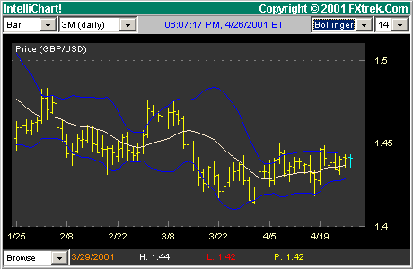
Bollinger Bands

Slide 86
PARABOLIC
If you are long (i.e., the price is above the SAR), the SAR will move up every day, regardless of the direction the price is moving. The amount the SAR moves up depends on the amount that prices move.
The Parabolic SAR provides excellent stops. You should close long positions when the price falls below the SAR and close short positions when the price rises above the SAR.
Each SAR stop level point is displayed on the day in which it is in affect. Note that the SAR value is today's, not tomorrow's stop level.
Explanation:
The Parabolic Time/Price System or SAR (stop-and-reversal), developed by J. Welles Wilder, is usually used to set trailing price stops.
The parameters are specified at the time the indicator is plotted. As the quote makes new highs/lows, the Parabolic SAR will rise/fall according to the SAR step size, the acceleration factor. The standard value of this factor is 0.02, which is also used in the current chart. For example, if new highs appeared for three consecutive

Slide 87
STOCHASTICS
The Stochastic oscillator compares where a price closed relative to its trading range over the last x-time periods.
The formula for the %K parameter of the Stochastic is:
(today's close-lowest low %K periods)/(highest high %K periods-lowest low %K periods)
A moving average of %K is then calculated using the number of time periods you specified in the %D Periods. This moving average is called %D.
Finally, we multiply all stochastic values by 100 to change decimal values into percentages for better scaling (e.g., 0.375 is displayed as 37.5%).
The Stochastic oscillator always ranges between 0% and 100%. A reading of 0% shows that the security's close was the lowest price that the security has traded during the preceding x-time periods. A reading of 100% shows that the security's close was the highest price that the security has traded during the preceding x-time periods.
Interpretation:
Stochastic oscillators can be used as both short- and intermediate-term trading oscillators depending on the number of time periods used when calculating the oscillator. When displaying a short term Stochastic oscillator (e.g., 5-25 days), it is popular to slow the %K value by 3-days.
There are several ways to interpret a Stochastic oscillator. Three popular methods include:
1. Buy when the oscillator (either %K or %D) falls below a specific level (e.g. 20) and then rises above that level, and sell when the oscillator rises above a specific level (e.g. 80) and then falls below that level.
2. Buy when the %K (blue) line rises above the %D (red) line and sell when the %K line falls below the %D line.
3. Look for divergences. For example, where prices are making a series of new highs (lows) and the Stochastic oscillator is failing to surpass its previous highs (lows).

Slide 88
MOVING AVERAGES
Moving Average:
Moving average is a method of calculating the average value of a security's price, or indicator, over a period of time. The term "moving" implies, that the average changes or moves. The simple, or arithmetic, moving average gives equal weight to each price.
Example of a 3-day simple moving average:
MA = (today's close + yesterday's close + day-before-yesterday's close) / 3
Variations of this calculation are also widespread. A weighted moving average is designed to put more weight on recent data and less on past data, the same, but stronger, effect has the exponential moving average, where the data are exponentially weighted. Exponential moving averages are used in the MACD indicator.

Slide 89
Lesson 13
TRADING STRATEGIES
Break Out Trades:
Price Breaks Through Resistance or Support Strategy- Buy or Sell in Direction of Break
Bounce Trades
Price Fails to Break Through Resistance or Support and
Bonces the other way.
Strategy- Buy or Sell in Direction of Bounce.

Slide 90
Position vs. Day Trading
The main difference is the requirement to hold a position overnight, introducing rollover costs and increased risk exposure.
Both position and day trading need the same technical analysis.

Slide 91
Lesson 14
TYPES OF ORDERS
OPEN (enter) - Your starting your position as a Buy or a Sell
CLOSE (Liquidating)- Your liquidating your position.
MARKET- Immediately executed
STOP- If Market touches price stop -Order becomes Market Order.
There is no guarantee on exact price that will be filled.
LIMIT- Order filled at or a better price. Buy limits will be filled at the limit order or below. They cannot be filled higher. Sell orders will be filled at or above. They cannot be filled lower.
OCO (ONE CANCELLS OTHER)
GTC ( Good T’ll Cancelled)

Slide 92
Setting Stops
Monetary Decision- A Cash/ Pip Objective for what is your target profit or maximum risk.
  Technical Decision
  For Buyers- Sell Stop at Previous Low
  For Sellers- Buy Stop at Previous High
  Other technical indicators.

Slide 93
Lesson 15
KEY ACCOUNT TERMS
Equity- Value of total positions marked to the market.
Balance- amount held on the Customer’s account, which can be changed depending on the Customer’s performance on the market. Amendments are reflected on the balance only after a transaction is completed. Thus, the profit and loss open positions are not included in the balance.
Unrealized Profit/Loss - Value of open positions not yet
liquidated
Realized Profit/Loss- Value of positions after they are liquidated

Slide 94
Lesson 16
Preparing to Trade
Key steps for Trading are:
Scan the Markets
Identify Trends, Support and Resistance
Identify Buying or Selling Opportunities using technical analysis
Develop trading plan
Place Trade with Limits and Stops

Slide 95
TEST YOUR KNOWLEDGE
Thank you for taking the
E-course. Now go to:
www.LearnFX.net/e-course
And take our Test.

Slide 96
CONCLUSION
The Forex markets offer unprecedented opportunities for trading.
The best way to prepare is to have the right tools and training. LearnFX is pleased to offer all of our demo Account holders a special opportunity to receive training in forex.
LearnFX.net offers an Introduction to Forex Training course -right at your Desktop. All participants in the course will receive a 100% rebate of course tuition, when they proceed to trade .
Contact : training@learnfx.net

